Slide 1
Projektowanie złożonych systemów telekomunikacyjnych
Lecture 1: GIT Introduction
Łukasz Marchewka
04-03-2021

Slide 2
Agenda:
Git overview
Working on local repository
Working on branches
Synchronising local and remote repository

Slide 3
External materials:
Git online documentation:
https://git-scm.com/docs
Git CHEAT SHEET:
http://rogerdudler.github.io/git-guide/files/git_cheat_sheet.pdf
Learn Git Branching
https://learngitbranching.js.org/
Git School
https://git-school.github.io/visualizing-git/

Slide 4
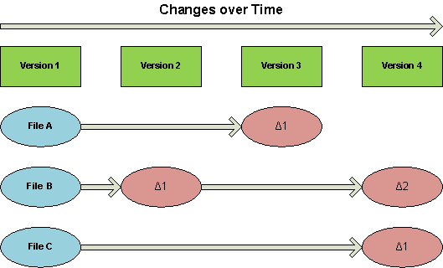
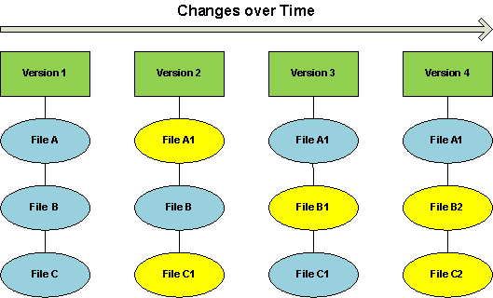
Git overview
The major difference between GIT and other VCS is that the consecutive commits are snapshot of full repository, instead of changes made to each file over time.
Git is distributed, whereas the most popular VCS (SVN) is centralized
SVN GIT
VS

Slide 5
Creating the repository
git init - creates an empty repository in current location
git init --bare
Creates an empty repository for sharing in current location – NOTE: it is not working # repository, so it is impossible to edit files and commit changes in that repository
Bare
Non-Bare
Non-Bare

Slide 6
Cloning the repository
git clone - clones the remote repository into chosen location
Copy almost all data that are on server.
git clone <repository_url>
Clones the repository in current location with the same repository name as the remote has.
git clone <repository_url> my_repository
Clones the repository in current location with the given repository name.

Slide 7
Status of the repository
git status – shows a status of the working repository
git status -s
Shows status in a short form
File status lifecycle:
Untracked
Unmodified
Modified
Staged
Add
Edit
Stage (git add)
Remove (git reset)
Commit

Slide 8
Creating branches, working on branches
git branch – shows branch, creates a branch
git checkout – switches to commit / branch
git branch
Shows branches and current branch
git branch myBranch
Creates branch „myBranch”
git checkout myBranch
Switches to branch „myBranch”
git checkout –b myBranch
Creates and switches to branch „myBranch”
git checkout -- <path>
Checkouts files in „path” to „HEAD” version

Slide 9
Adding new files to repository, staging
git add – moves the files from modified state into staged state. It is also used to add new files to the repository
git add file.txt
Adds „file.txt” into staged state
git add .
Adds all files in the current location (and recursively in subdirectories) into staged state
git add src/*.cpp
Adds all „.cpp” files in „src” directory into staged state

Slide 10
Committing the changes
git commit – saves the changes in the repository into snapshot (staged files now are in commited state)
git commit –m "example commit message„
Commits the files with comment: „example comment”
git commit –a src/*.cpp
Adds all „.cpp” files from „src” dir into staged state and then performs the commit
git commit –-amend
Adds staging area to previous commit
Example:
$ git commit –m „first commit”;
$ git add forgottenFile;
$ git commit --amend

Slide 11
Undoing the changes in the repository
git reset – changes the state of staged files from to be committed into modified state
git reset –-hard
Move the last commit (with local changes) into trash
git clean –f –d
Removes local files that are not in repository
git reset –-soft HEAD^
Changes the state of commit from commited into staged state
git reset –-hard HEAD^
Moves the last commit (do not touch local changes) into trash

Slide 12
Undoing the changes in the repository
git revert – reverts the commits in the repository
git revert a867b4af
Creates the commit which reverts changes applied by commit: „a867b4af”
git revert HEAD~2..HEAD
Creates the commit which reverts two last commits
git revert --no-commit 0766c053..HEAD
Reverts the changes applied by commit(s): 0766c053 to HEAD commit without creating a new commit

Slide 13
Removing files from the repository
git rm – removes the file/path from repository
git rm file1.txt
Removes the file from reposiotry if no staged changes
git rm file1.txt –f
Removes the file from repository and forces removal from filesystem
(applies for files in staged state)
git rm file1.txt --cached
Removes the file from repository and keeps cached copy

Slide 14
Displaying the changes in the repository
git log – shows commit logs
git log src/main.cpp
Shows commits containing changes in „src/main.cpp”
git log -3
Shows last 3 commits
git log --since="1 day ago„
Shows commits since 1 day ago
git log --pretty=oneline
Shows commits and formats the output in one line description

Slide 15
Displaying the changes in the repository
git show – shows description of git objects (commits/tags/trees)
git show e32236ae
Shows the description (and changes) of the commit with id: „ e32236ae”
git show v0.6
Shows the description of tag: „v0.6”

Slide 16
Displaying the changes in the repository
git diff – shows differences between working copy/HEAD, commits and other objects
git diff branch1..master
Shows the difference between branches: branch1 and master
git diff HEAD^ HEAD
Shows the difference between current and previous commit
git diff HEAD~
Shows the difference between last but one commit and last commit (and current state, if any)
git diff <commit_id1> <commit_id2>
Shows the difference between commits: commit_id1 and commit_id2

Slide 17
States transitions
Commited
commit
checkout
reset --soft
reset --hard
Staged
add
reset --mixed
rm
Untracked files
Working directory
Trash

Slide 18
Excercise 1

Slide 19
Excercise 1
Log in and create an account on github: http://github.com/
Fork the repository from: https://github.com/pgum/NOKIA-PK-2021
Alternatively: Import the repository, however you will miss the updates in the main repository

Slide 20
Excercise 1 - Solution
Fork the repository from: https://github.com/pgum/NOKIA-PK-2021

Slide 21


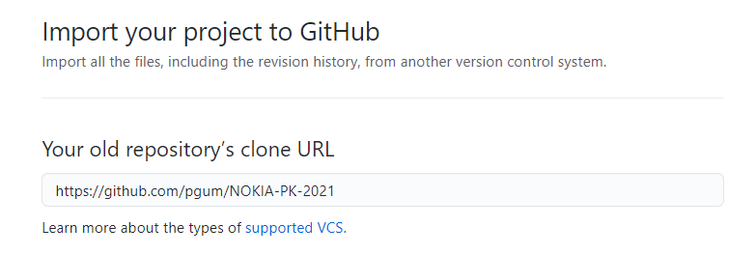
Excercise 1 - Solution
Import the repository from: https://github.com/pgum/NOKIA-PK-2021

Slide 22
Excercise 2
Clone the repository from your github account, not from pgum.
Create a branch „gitIntro”
Add new file „myGitBranches” with a list of existing git branches
Check the repository status
Add the file to the stage
Check the repository status
Add the file to version control
See the history of the repository

Slide 23
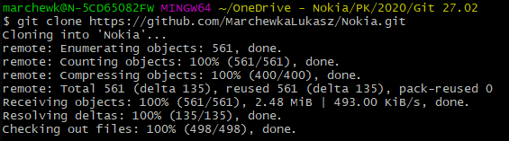

Excercise 2 - Solution
Clone the repository from your github account, not from pgum.
$ git clone <URL_TO_YOUR_GITHUB_REPO>
Create a branch „gitIntro”
$ git checkout –b gitIntro

Slide 24
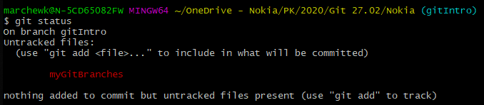
Excercise 2 - Solution
Add new file „myGitBranches” with a list of existing git branches
$ git branch > myGitBranches
Check the repository status
$ git status

Slide 25
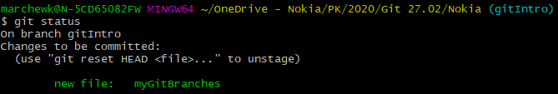
Excercise 2 - Solution
Add the file to the stage
$ git add myGitBranches / git add .
Check the repository status
$ git status

Slide 26

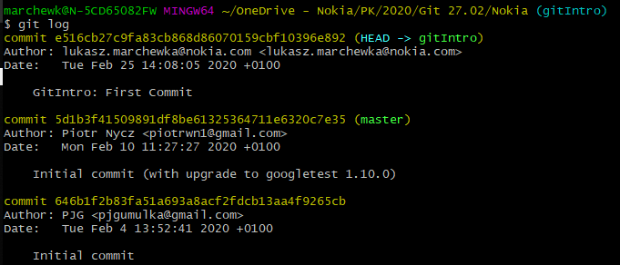
Excercise 2 - Solution
Add the file to version control
$ git commit –m „GitIntro: First Commit”
See the history of the repostiory
$ git log

Slide 27
Local and remote repository
Local and remote repositories have to be synchronized
Remote repository
push/pull
push/pull
fetch
fetch
clone
Commited
clone
Commited
Staged
Staged
Working directory
Working directory
User 1 local repository
User 2
local repository

Slide 28
Synchronisation of a local and remote repository
git pull – fetches the changes from a remote repository and integrates it
git push – uploads the changes to a remote repository
git pull --rebase
remote->local without merge the changes, put your commit on top of the tree until they are pushed to a remote server
git pull origin gitIntro
remote: gitIntro -> local:gitIntro
git fetch + git merge commands, that gives an extra commit
git push
local->remote
git push origin gitIntro
local: gitIntro -> remote: gitIntro
git push –u origin master
local:master -> remote:master and set the „master” branch as default for the next pull/push operations

Slide 29
Synchronisation of a local and remote repository
git remote – adds/remove tracking (remote) repositories
git remote add origin <repo_url>
Adds remote repository with address: „repo_url”
git remote –v
Verifies remote repository

Slide 30
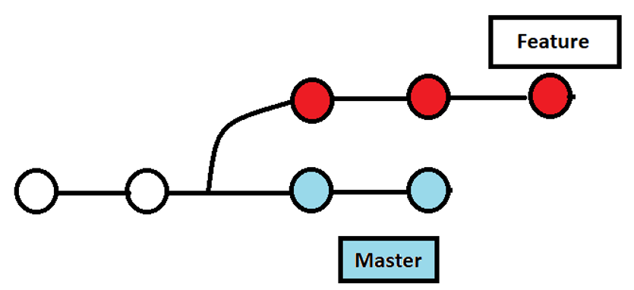
Rebase vs merge

Slide 31
Rebasing changes between branches
git rebase – integrates two or more development branches by reapplying commits on top.
Remember: Never use on public branches
git rebase gitIntro
Issued on master branch merges changes from myBranch to master
git rebase –i gitIntro
Opens the editor and lists all the commits that are to be moved

Slide 32
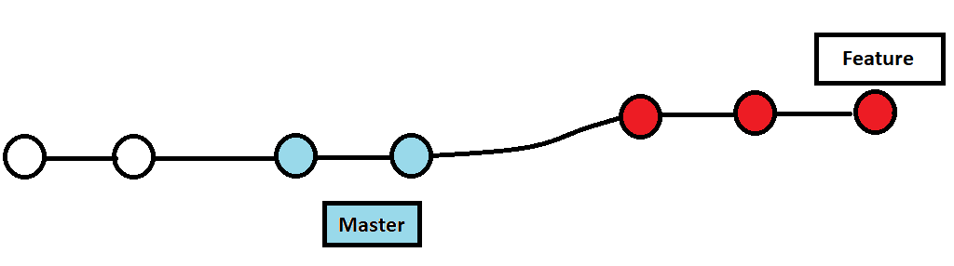
Rebasing changes between branches
Rebase feature branch onto master

Slide 33
Merging changes between branches
git merge – integrates two or more development branches
git merge gitIntro
Issued on master branch merges changes from myBranch to master
git merge master
Issued on myBranch_1 merges changes from master to myBranch
git merge -–abort
Aborts the merge operation (if already running)
git mergetool
Opens mergetool to perform the merge

Slide 34
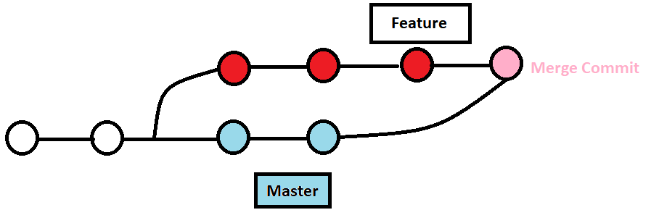
Merging changes between branches
Creates a merge commit

Slide 35
Excercise 3

Slide 36
Excercise 3
Switch to master branch
Add new file „myGitBranches” with a list of existing git branches and commit it to repository
Rebase master branch into gitIntro
Resolve conflicts
Check the history
Merge gitIntro to master
Check the history
Push the changes into your remote repository

Slide 37
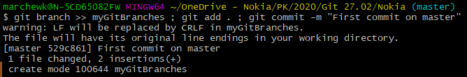
Excercise 3 - Solution
Switch to master branch
$ git checkout master
Add new file „myGitBranches” with a list of existing git branches and commit it to repository
$ git branch >> myGitBranches; git add . ; git commit –m „GitIntro: First commit on master”

Slide 38
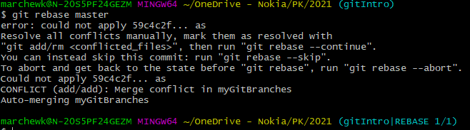
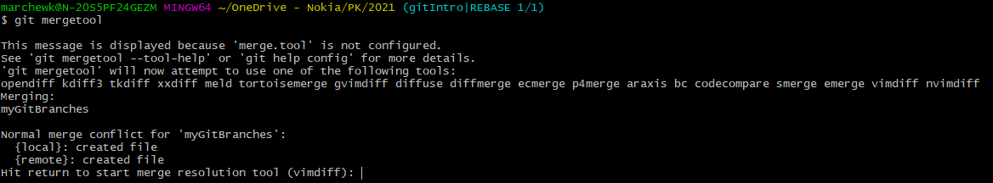
Excercise 3 - Solution
Rebase gitIntro branch into master and resolve conflicts
$ git rebase master
$ git mergetool

Slide 39
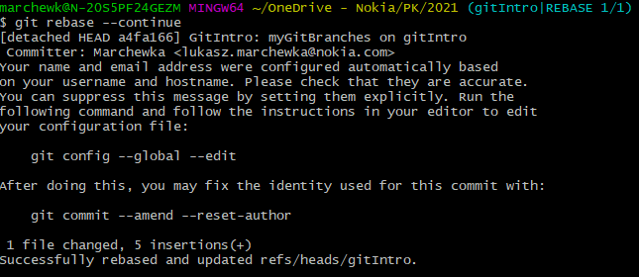
Excercise 3 - Solution
$ git rebase --continue

Slide 40
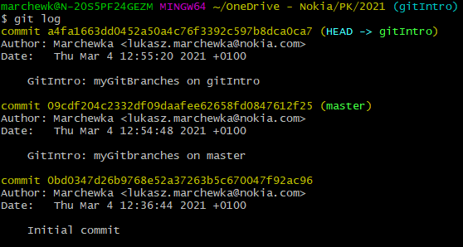
Excercise 3 - Solution
Check the history
$ git log
Switch to master branch
$ git checkout master

Slide 41
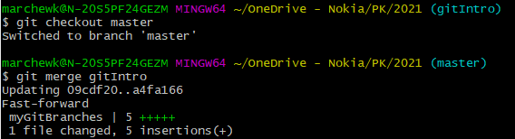
Excercise 3 - Solution
Merge gitIntro into master
$ git merge gitIntro

Slide 42
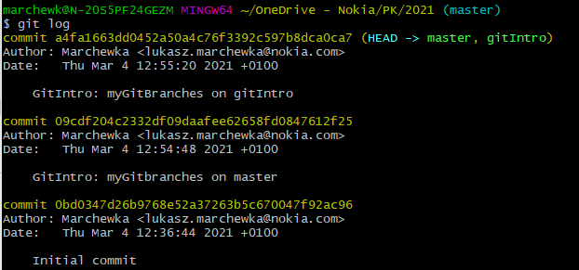
Excercise 3 - Solution
Check the history
$ git log
Push the changes into your remote repository

Slide 43
Excercise 4

Slide 44
Excercise 4
Switch to gitIntro branch
Clear the content of „myGitBranches” file and commit it to repository.
Check the history of the repository
Make some additional change in „myGitBranches” and add it to previous commit
Check the history of the repository
Remove last commit from the repository (use: git revert)
Check the history of the repository
Remove two last commits from the repository (use: git reset)
Check the history of the repository

Slide 45
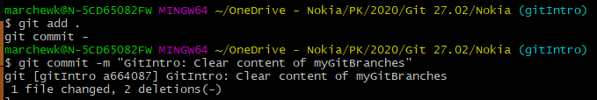
Excercise 4 - Solution
Switch to gitIntro branch
$ git checkout gitIntro
Clear the content of „myGitBranches” file and commit it to repository.
$ > myGitBranches; git add . ; git commit –m „GitIntro: Clear content of myGitBranches”

Slide 46
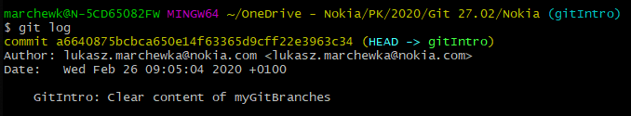
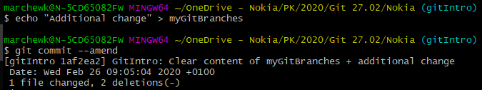
Excercise 4 - Solution
Check the history of the repository
$ git log
Make some additional change in „myGitBranches” and add it to previous commit
$ echo „Additional changes” > myGitBranches; git commit --amend

Slide 47
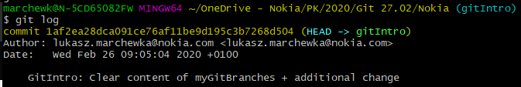

Excercise 4
Check the history of the repository
$ git log
Remove last commit from the repository (use: git revert)
$ git revert <commit-ish>

Slide 48
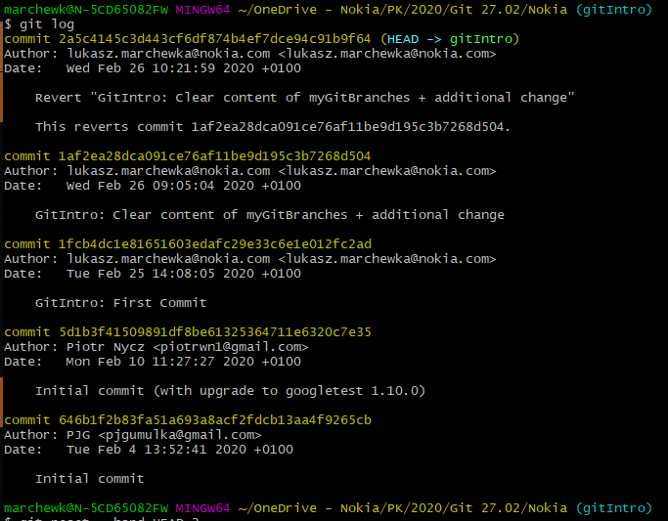
Excercise 4
Check the history of the repository: $ git log
Remove two last commits from the repository (use: git reset)
$ git reset –-hard HEAD~2

Slide 49
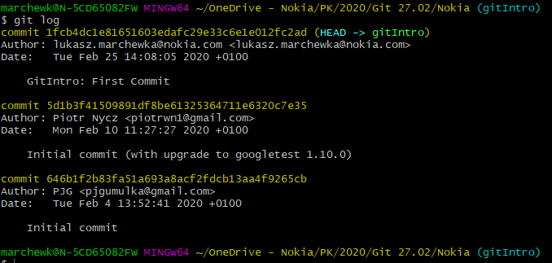
Excercise 4
Check the history of the repository:
$ git log

Slide 50
Excercise 5

Slide 51
Excercise 5
Change the content of HEAD~2
Check the history of the repository
Squash last two commits into one
Check the history of the repository
Remove branch gitIntro

Slide 52
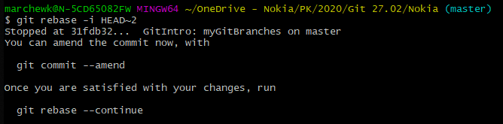
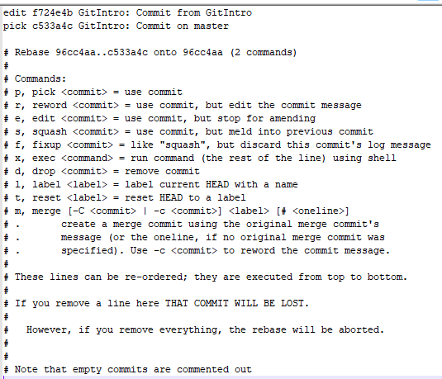
Excercise 5 - Solution
Change the content of HEAD~2
$ git rebase –i HEAD~2

Slide 53
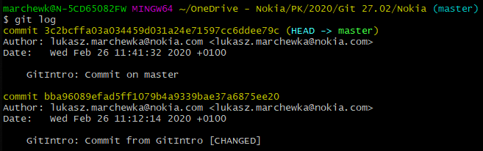

Excercise 5
Check the history of the repository
$ git log
Squash last two commits into one
$ git rebase –i HEAD~2

Slide 54
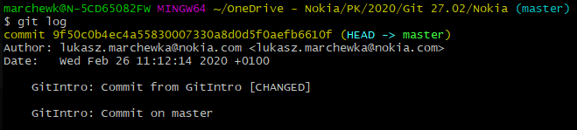
Excercise 5
Check the history of the repository
$ git log
Remove branch gitIntro
$ git branch –D gitIntro

Slide 55
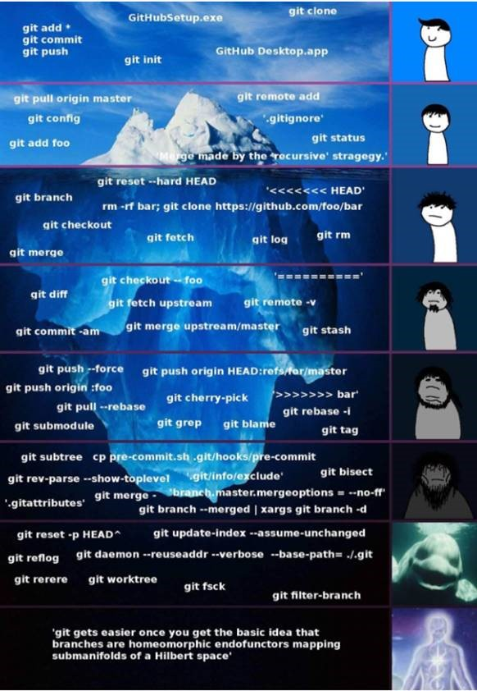

Slide 57
Copyright and confidentiality
The contents of this document are proprietary and confidential property of Nokia. This document is provided subject to confidentiality obligations of the applicable agreement(s).
This document is intended for use of Nokia’s customers and collaborators only for the purpose for which this document is submitted by Nokia. No part of this document may be reproduced or made available to the public or to any third party in any form or means without the prior written permission of Nokia. This document is to be used by properly trained professional personnel. Any use of the contents in this document is limited strictly to the use(s) specifically created in the applicable agreement(s) under which the document is submitted. The user of this document may voluntarily provide suggestions, comments or other feedback to Nokia in respect of the contents of this document ("Feedback"). Such Feedback may be used in Nokia products and related specifications or other documentation. Accordingly, if the user of this document gives Nokia Feedback on the contents of this document, Nokia may freely use, disclose, reproduce, license, distribute and otherwise commercialize the feedback in any Nokia product, technology, service, specification or other documentation.
Nokia operates a policy of ongoing development. Nokia reserves the right to make changes and improvements to any of the products and/or services described in this document or withdraw this document at any time without prior notice.
The contents of this document are provided "as is". Except as required by applicable law, no warranties of any kind, either express or implied, including, but not limited to, the implied warranties of merchantability and fitness for a particular purpose, are made in relation to the accuracy, reliability or contents of this document. NOKIA SHALL NOT BE RESPONSIBLE IN ANY EVENT FOR ERRORS IN THIS DOCUMENT or for any loss of data or income or any special, incidental, consequential, indirect or direct damages howsoever caused, that might arise from the use of this document or any contents of this document.
This document and the product(s) it describes are protected by copyright according to the applicable laws.
Nokia is a registered trademark of Nokia Corporation. Other product and company names mentioned herein may be trademarks or trade names of their respective owners.

Slide 58
Revision history and metadata
Please delete this slide if document is uncontrolled
Document ID: DXXXXXXXXX Document Location: Organization:
Version | Description of changes | Date | Author | Owner | Status | Reviewed by | Reviewed date | Approver | Approval date
 |  | DD-MM-YYYY |  |  |  |  | DD-MM-YYYY |  | DD-MM-YYYY

